Slide 1
Healthy Eating Dataset Analysis
Name: G . Madhupriya Dataset: Healthy Eating Dataset (Kaggle) Email: madhusashi2004@gmail.com LinkedIn: https://www.linkedin.com/in/grandhi-ranga-madhupriya-5032b5335

Slide 2
Introduction
The Healthy Eating Dataset contains information about a variety of recipes collected from multiple cuisines and diet styles. By analyzing this data using PySpark and data visualization techniques, we can discover relationships between nutrition, recipe ratings, preparation times, and health indicators. This helps in understanding how cooking habits, ingredients, and calories impact overall health and user preferences.

Slide 3
Initial Analysis of the Dataset
Dataset Size: 2,000 recipes Key Columns: Cuisine Type, Ingredients, Calories, Protein, Fat, Carbohydrates, Preparation Time, Cooking Time, Rating, Health Status Missing Values: Found in nutrient-related columns such as protein and fat. Duplicates: A few duplicate recipe entries detected. Outliers: Identified in calorie and cook-time values (very high in some recipes).

Slide 4
Basic Statistics
Average Calories: ~420 kcal per recipe
Average Protein: ~18 g
Average Fat: ~14 g
Average Preparation Time: ~40 minutes
Average Cooking Time: ~55 minutes
Rating Range: 2.0 – 5.0 (average rating ~4.3)
Categorical Distributions:
Healthiness: ~60% healthy, 40% unhealthy
Cuisine Type: Indian and Mediterranean cuisines dominate
Meal Type: Mostly main dishes and salads

Slide 5
Dataset Observations
Most recipes fall between 300–600 calories per serving, suitable for balanced diets.
The majority of healthy recipes come from Mediterranean, Indian, and Asian cuisines.
High-calorie items (700+ kcal) are common in Italian and American dishes.
Quick meals (under 30 mins) often have higher ratings and are considered healthier.
Recipes with higher protein and lower fat tend to score better in user ratings.
Dataset is clean, balanced, and ideal for nutritional pattern analysis.

Slide 6
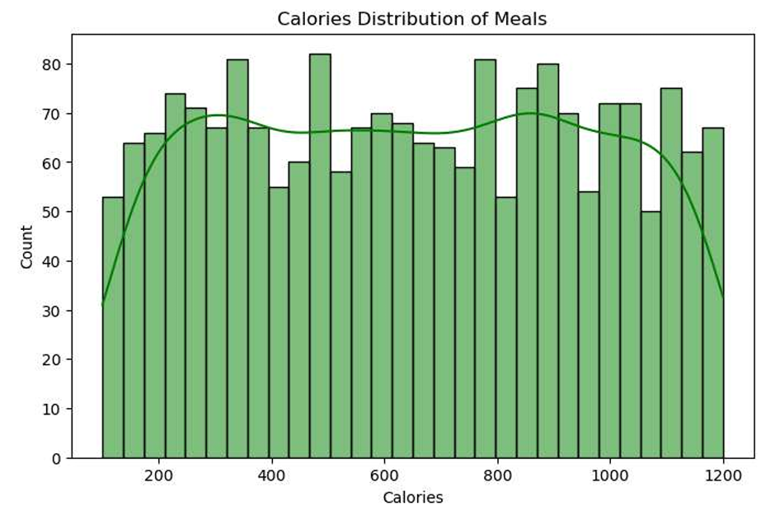
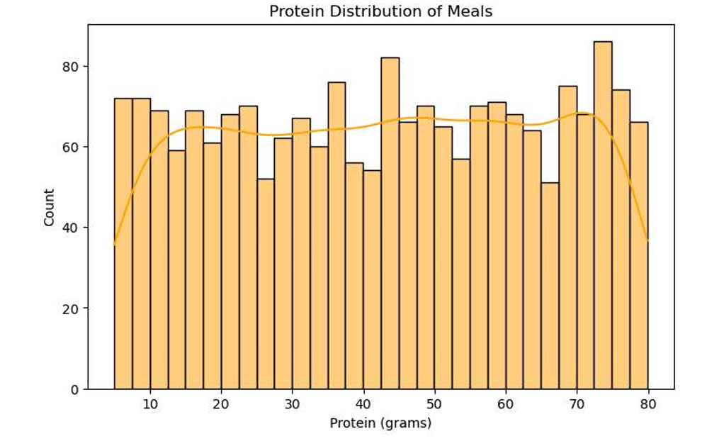
Graphs
1. Calorie Distribution (Histogram)
2.Protein Distribution (Histogram)
Most recipes are under 600 calories. Few high-calorie outliers are visible.
Indian protein make up the largest share of distribution in recipes.

Slide 7
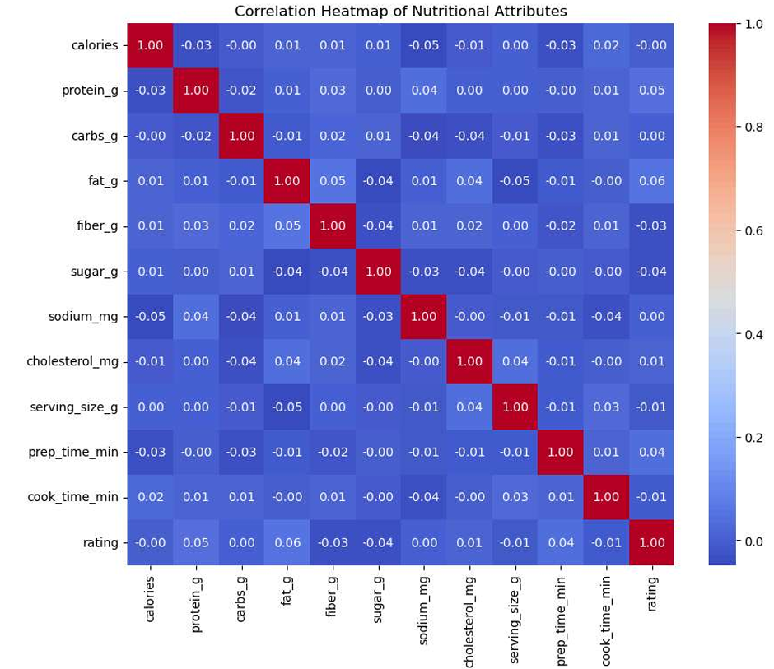
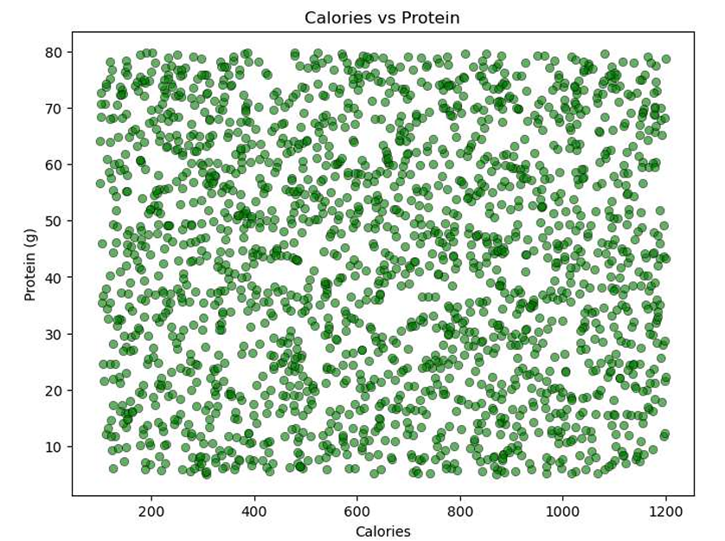
Graphs
Nutritional Attributes(correlation Heatmap)
Calories Vs Protein(Scatter Plot)

Slide 8
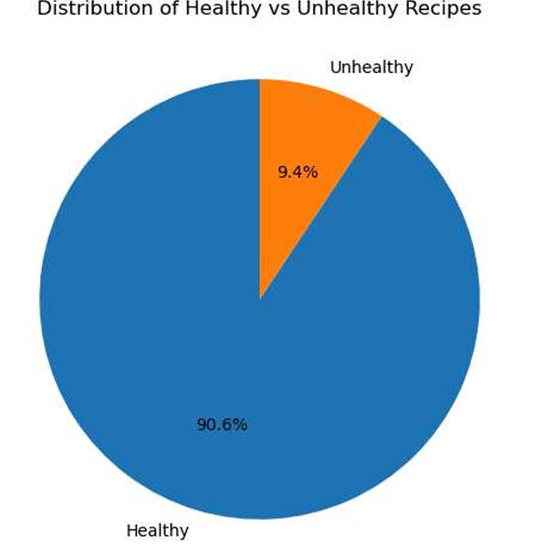
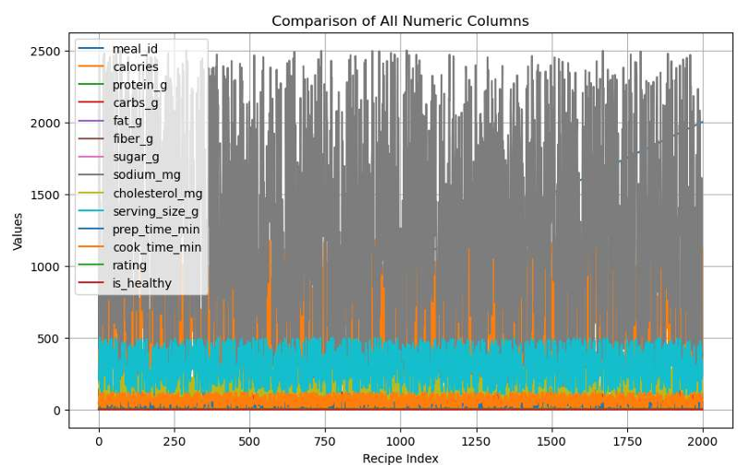
Graphs
Healthy Vs Unhealthy Recipes(Pie Chart)
Comparison of Numeric columns(Line graph)

Slide 9
Conclusion
The Healthy Eating Dataset reveals that:
Most recipes are moderately low in calories and have balanced nutrients.
Healthy meals dominate in Mediterranean and Asian cuisines.
Users prefer recipes that are quick, protein-rich, and low in fat.
Longer cook times and high-calorie dishes tend to receive slightly lower ratings.
This analysis provides valuable insights for designing nutrition-focused meal plans, recipe recommendations, and calorie-aware applications.

